Slide 1
Understanding and Documenting the User Interface
Usability Engineering: Process, Products, and Examples
Chapter 5

Slide 2
Analysis
Understanding the context and the details of the problem (i.e., the UI) from the user’s perspective.

Slide 3
Specification
Producing detailed documents that spell out as specifically as possible what the UI for the product will be like.

Slide 4
Two Primary Types of Activities
Context setting
  Understanding and specifying
    General usability expectations
    Needs and features
    Feasibility and constraints
  Project Planning and Resource Scheduling
Analyzing and specifying the problem
  Use case analysis and user profile specifications
  Task analysis and specification
  Analysis and documentation of usability requirements
    E.g., Identification and definition of what “easy to learn” means.

Slide 5
What is the Process?
Sell your idea and determine if it is feasible.
  Establish need, expectations and constraints.
  Perform a feasibility study to determine if the project is feasible (for you and your customer).
Plan and schedule the project and its resources.
Understand and specify the problem.
  Analyze and specify user task requirements.
  Analyze user characteristics and generate user profiles.
  Analyze and specify usability requirements.

Slide 6
Understanding Users by Understanding their Tasks
Strategies
  Use case analysis
  Analysis of scenarios
  Hierarchical task analysis
We show a strategy that combines elements of these three.

Slide 7
Task Analysis and Specification
STEP 1. Start with a narrative description of the tasks that the user wishes to accomplish with the proposed user interface.
STEP 2. Look at a number of scenarios describing specific tasks that someone might do with our interface.
STEP 3. For each scenario, build an informal use case diagram.

Slide 8
Task Analysis and Specification Continued
STEP 4. From the collection of informal use case diagrams, we will extract primary entities.
STEP 5. With our informal use case diagrams and models of primary entities, we will consolidate to form a high-level use case diagram that shows what tasks a user might perform with the interface.

Slide 9
Task Analysis and Specification Continued
STEP 6. For each use case, we will perform hierarchical task decomposition (hierarchical task analysis).
STEP 7. For each task in each task decomposition, we will develop a multipoint descriptive narrative.
STEP 8. For each task, we will consider any other information that the user has shared.

Slide 10
Why is it hard to build a task analysis from scenarios?
Scenarios are specific.
The tasks in a task analysis are abstract.
The developer must synthesize several specific scenarios into abstract tasks.

Slide 11
Steps 1 - 3
If your task specification is derived from scenarios, here are some rules of thumb:
  There should be a mixture of simple and more complex tasks.
  Producing an effective set of tasks will be a real test of the designer's understanding of the users and their work.
The specific scenarios can be integrated into descriptions of more abstract tasks.
Notes:
Mixing of simple and complex tasks is very important

Slide 12
How to synthesize...
The trick is to identify what is common across scenarios.
We will look at a simple strategy to accomplish this.
Our example problem is “bake a cake.”

Slide 13
Example
Use case models show interactions between external actors or roles (represented by stick people) and the use case (enclosed in the oval)

Slide 14
Example, continued
Develop a high-level use case model for each scenario showing the tasks that the user performs as indicated by the scenario. In other words, abstract the scenarios, one scenario at a time.
Combine/rebuild the original, scenario-by-scenario use case models into a single, more abstract model.
  The actors are aggregates of the roles played by specific users.
  The use cases suggest high level tasks for the hierarchical task analysis.

Slide 15
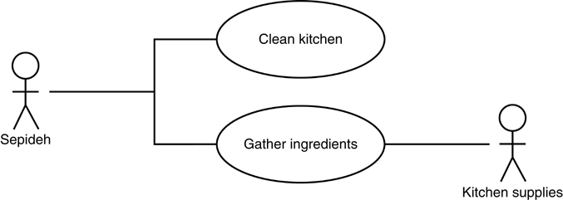
Example, continued

Slide 16
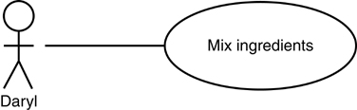
Example, continued

Slide 17
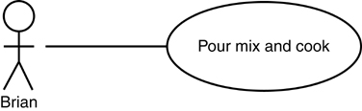
Example, continued

Slide 18
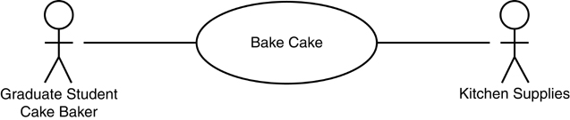
Example, continued

Slide 19
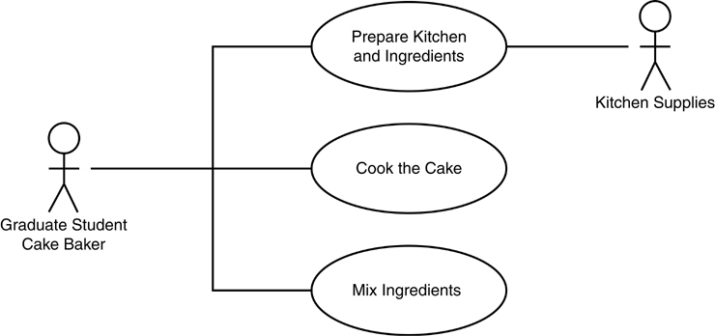
Example, continued

Slide 20
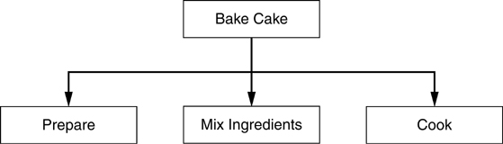
Example, continued

Slide 21
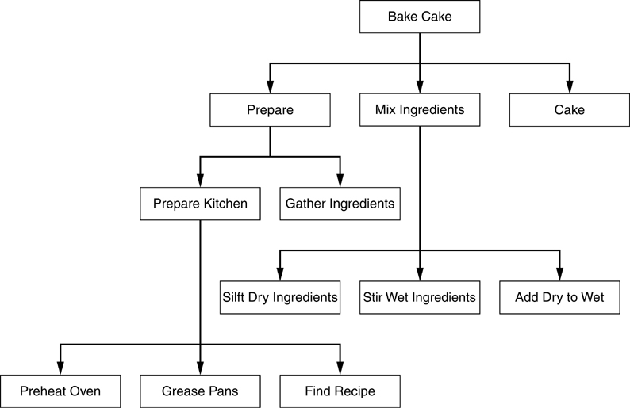
Example, continued

Slide 22
What Else?
Every task should be accompanied by a written description which answers a number of questions.
The answers to these questions will convey critical information to the designer and form an essential part of the problem definition.

Slide 23
User Profiles
Document user characteristics including
  User expertise
  User motivation
  User feedback about job functions
  How the user interface will impact the user’s job

Slide 24
Conclusions
We have described two documents to help you specify the problem that you will eventually be solving with your interface.
  Task specification
  User profiles
You may also generate documentation about the context and feasibility of your project.

